Slide 1
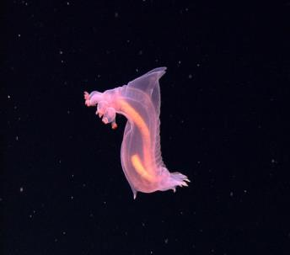
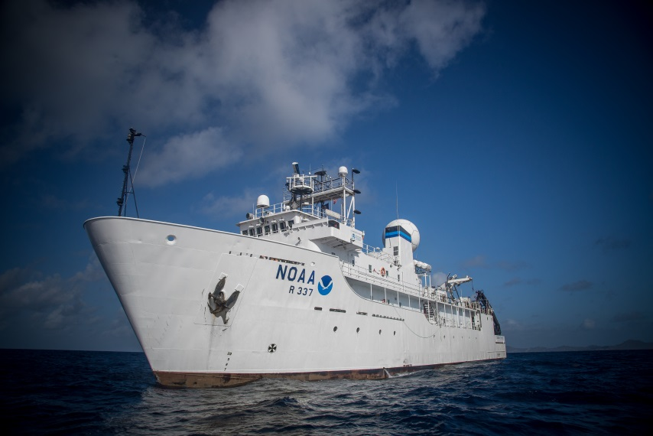
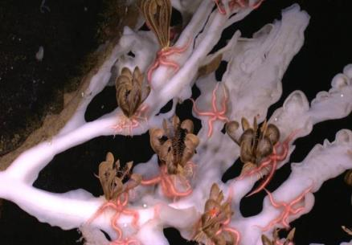

Exploring the Deep Ocean with NOAA
NOAA Office of Ocean Exploration and Research
Professional Development Workshop

Slide 2
Agenda
Time | Item
8:30 am | Welcome/Introductions/Ice Breaker
9:00 am | Agenda/NOAA OER/Okeanos Explorer History of Ocean Exploration and Modern Reasons Why Do We Explore? Keynote Address Why Do We Explore? Book Introduction ACTIVITY: To Boldly Go! Energy Intro ACTIVITY: What’s the Big Deal?
10:40 am | Break
10:50 am | Ocean Health Intro Carbonate Buffer System Overview ACTIVITY: Ocean Acidification
11:15 am | How Do We Explore? Book Introduction Multibeam Mapping Intro ACTIVITY: Wet Maps DEMO: Watching in 3D
12:15 pm | Lunch
Time | Item
1:00 pm | CTD Intro ACTIVITY: Oceanographic Yo-Yo Ocean Explorer and Okeanos Explorer Web Sites/Recent Expeditions/Digital Atlas ROVs Intro ACTIVITY: Invent a Robot
2:30 pm | Group Planning and Reflection
2:50 pm | Break
3:00 pm | Telepresence & Event Log Discussion ACTIVITY: What Little Herc Saw Discuss Exploring Live! Lesson
3:45 pm | Reflections/Post-surveys/ Certificates of Participation
4:00 pm | Adjourn

Slide 3
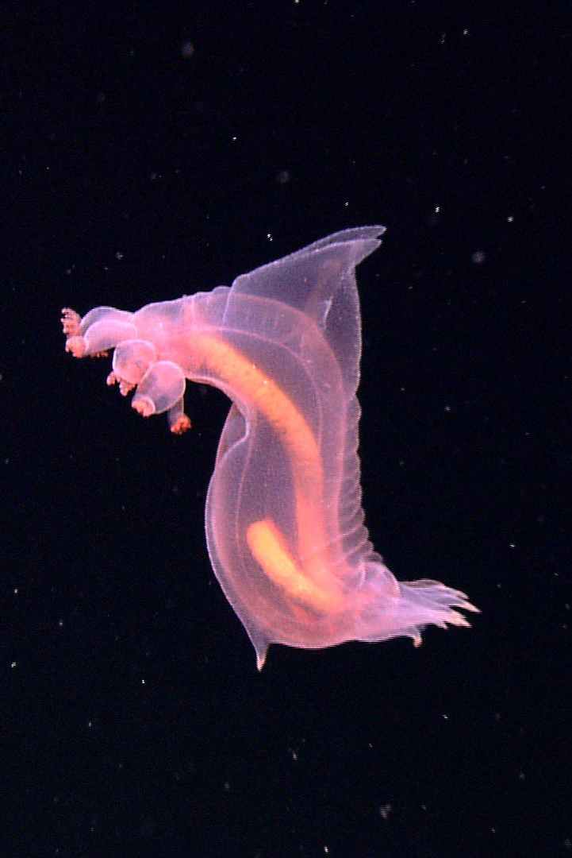
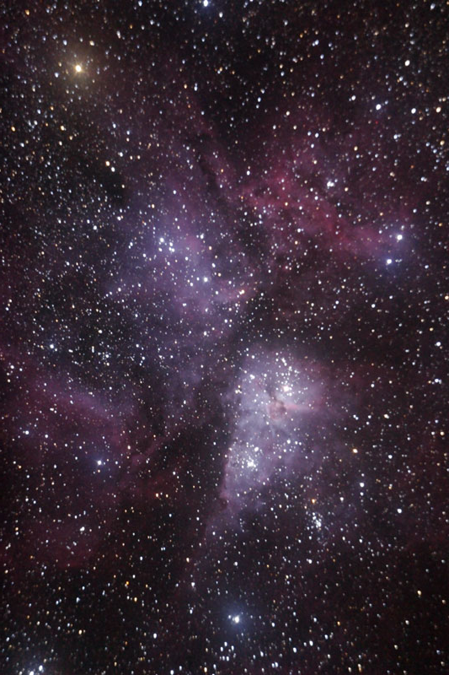
Exploration
Discovery

Slide 4
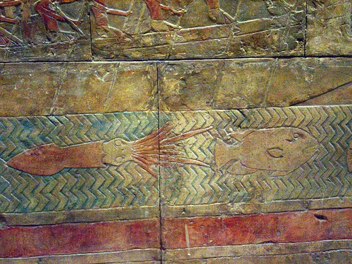
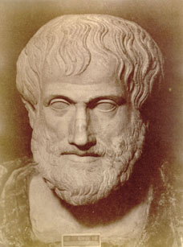

Slide 5
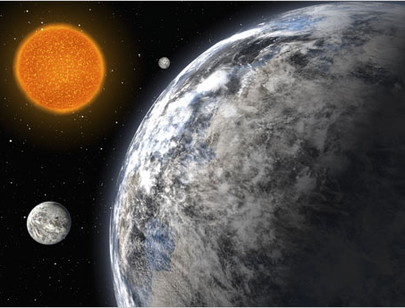

Slide 6
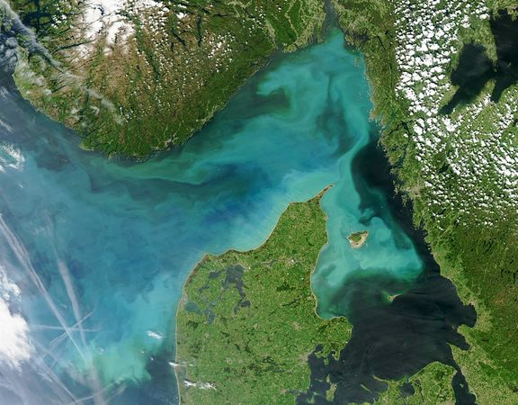

Slide 7
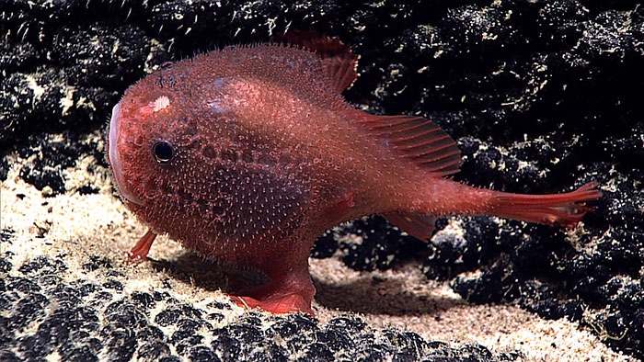
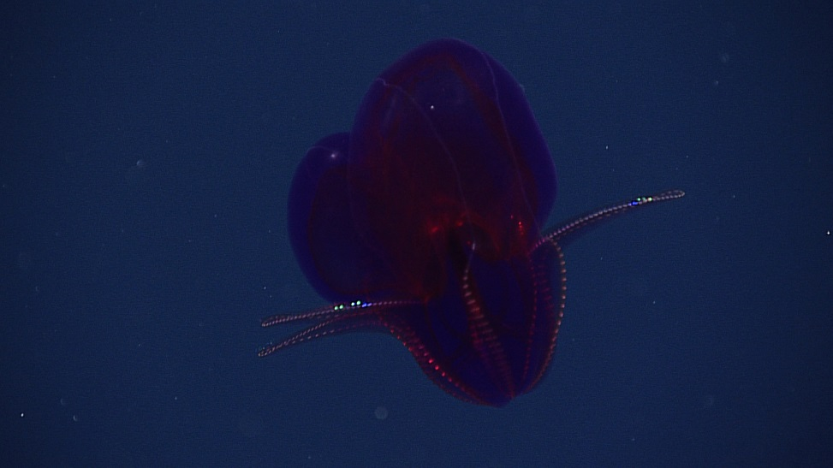
Notes:
Sea toad, HI 2015
Purple ctenophore, 1000 meters, Pacific near Hawaii, 2015

Slide 8
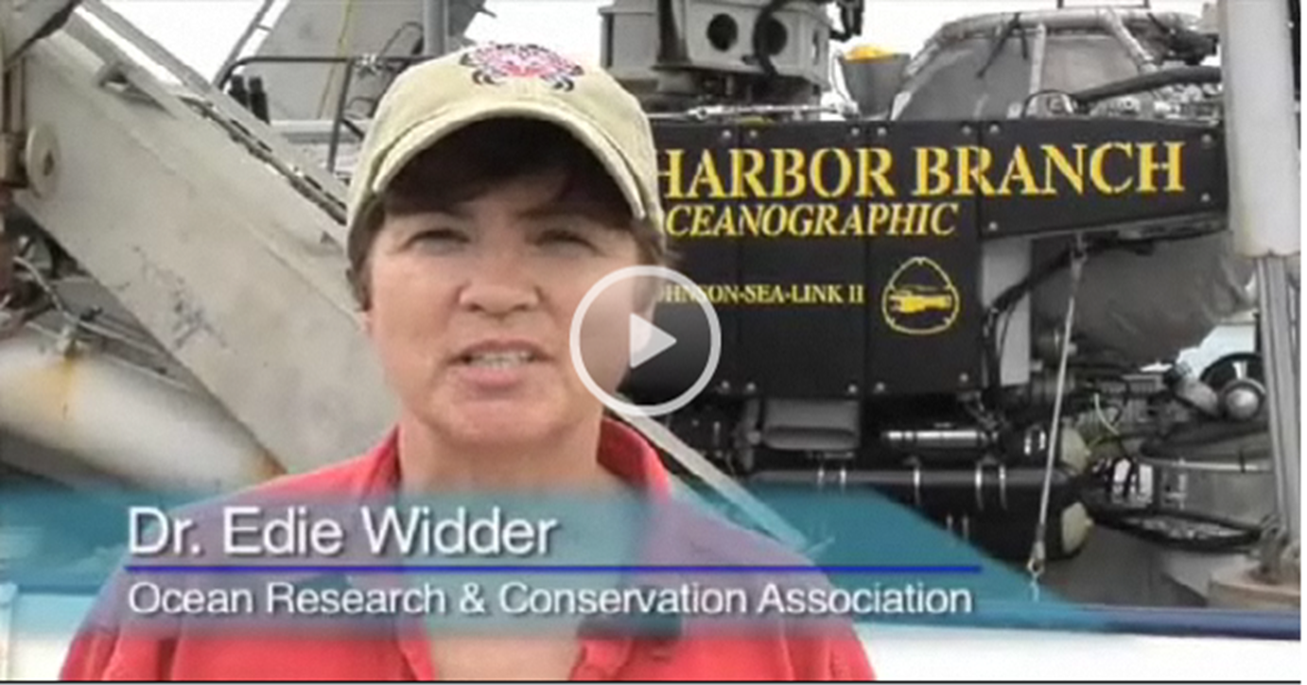
Why Do We Explore?
Notes:
http://oceanexplorer.noaa.gov/okeanos/explorations/10index/background/edu/media/keynote_wdwe_video.html

Slide 9

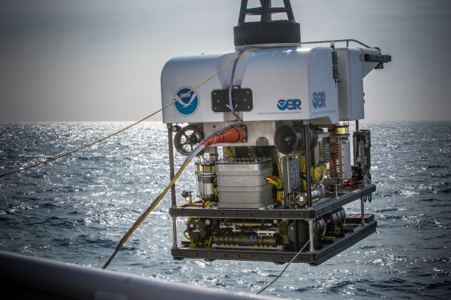
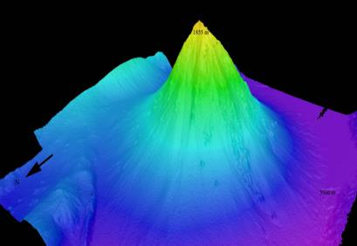
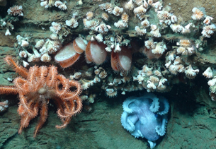
NOAA OER Mission and Purpose
MISSION: Explore the ocean for national benefit.
PURPOSE: America’s future depends on understanding the ocean. We explore the ocean because its health and resilience are vital to our economy and to our lives. We depend on the ocean to regulate weather and climate; sustain a diversity of life; for maritime shipping and national defense; and for food, energy, medicine, and other essential services to humankind.

Slide 10
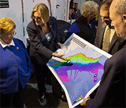
Ocean Exploration Act of 2009 (PL 111-11)
National Ocean Exploration Program will promote collaboration with other ocean and undersea research and exploration programs, both public and private - National Forum Process – coordination/planning mechanism
Partnerships – public, private, national, international by 2020
More ships, vehicles, new tools and technologies
Enhanced data sharing
Formal role for citizen scientists
More engaged public

Slide 11

Partners Building a National Ocean Exploration Program
NOAA Ship Okeanos Explorer
A dedicated ship of exploration linked in real time through telepresence technology
Length – 224 feet, Beam – 43 Feet, Draft – 15 feet, 46 berths, 30-day endurance

Slide 12
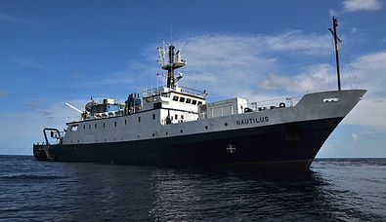
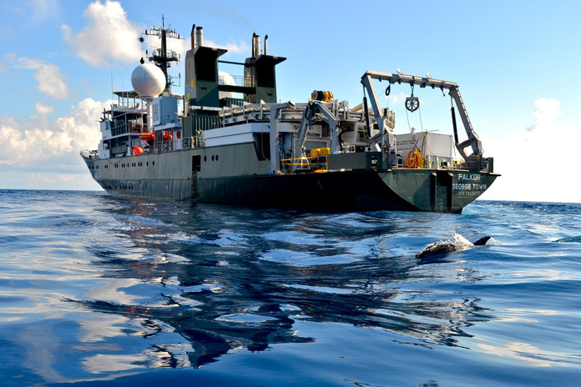
Ocean Exploration Trust
Exploration Vessel Nautilus
Schmidt Ocean Institute
Research Vessel Falkor
Length – 211 feet
Beam – 34.5 Feet
Draft – 14.75 feet
Berths – 48
Endurance - 40-day
Length – 272 feet
Beam – 42.7 Feet
Draft – 15.75 feet
Berths - 41
Endurance - 36-day

Slide 13
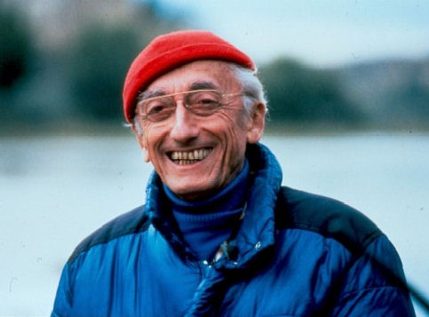
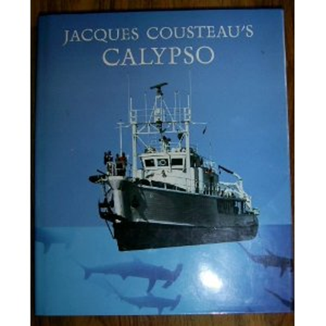
“The people who were putting up millions of dollars were asking my father, ‘So, Captain, what do you expect to find?’ and his answer to those people who were about to make major commitments was ‘If I knew, I wouldn’t go.’”
~ Jean-Michel Cousteau, 2005

Slide 14
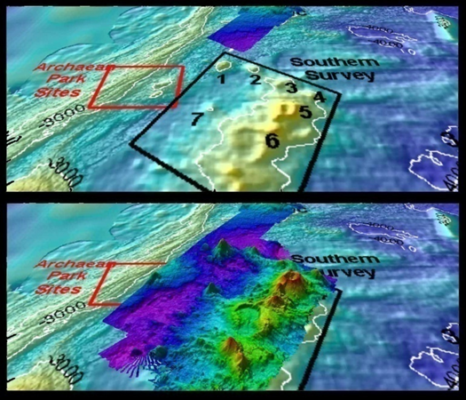
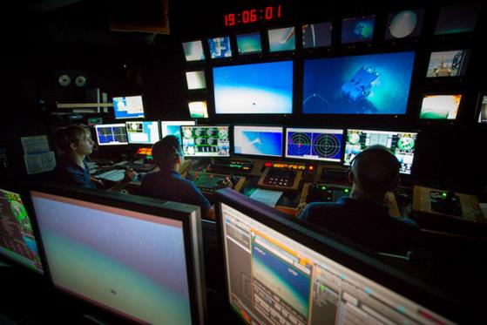
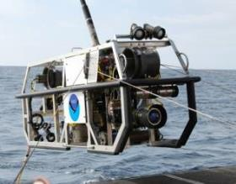
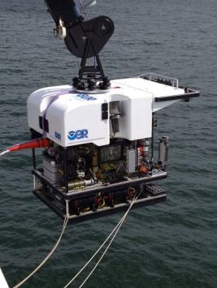
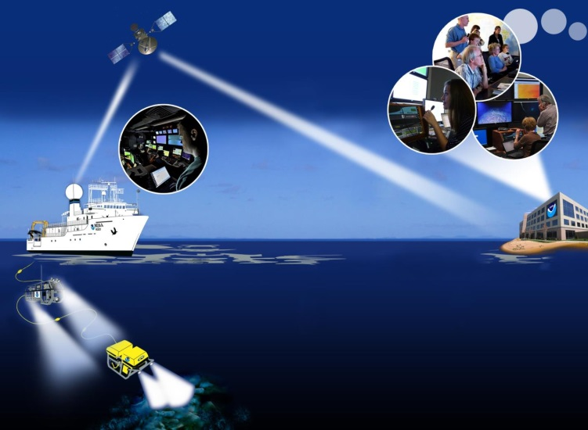
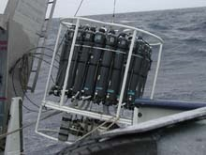
Ship Capabilities and Assets

Slide 15

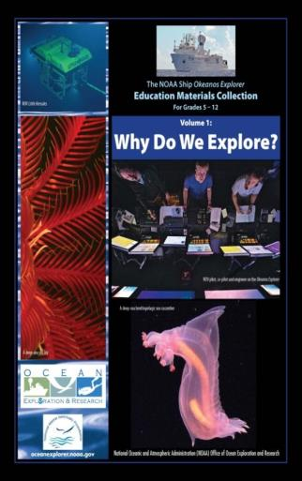
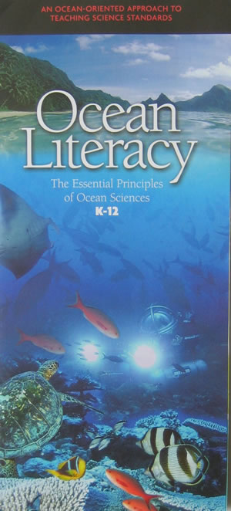
NOAA Ship Okeanos Explorer
Education Materials Collection
Volume 1:
Why Do We Explore?
Volume 2:
How Do We Explore?

Slide 16
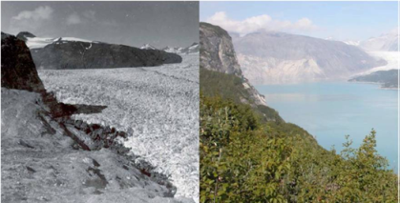
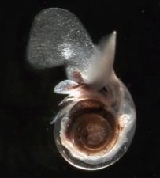

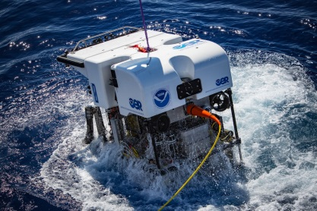
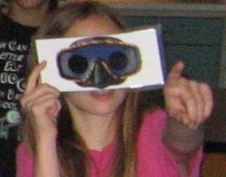
Why Do We Explore?
Climate Change
Energy
Human Health
Ocean Health
Research
Innovation
Literacy

Slide 17
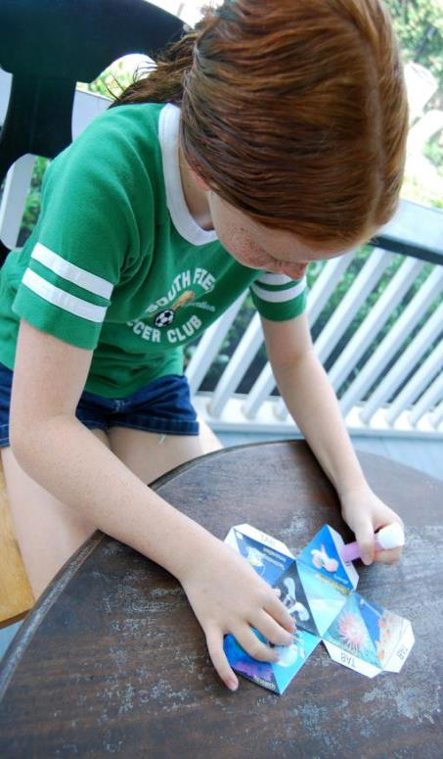
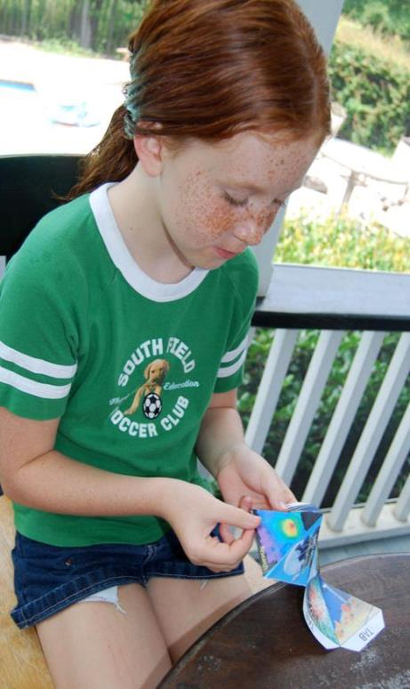
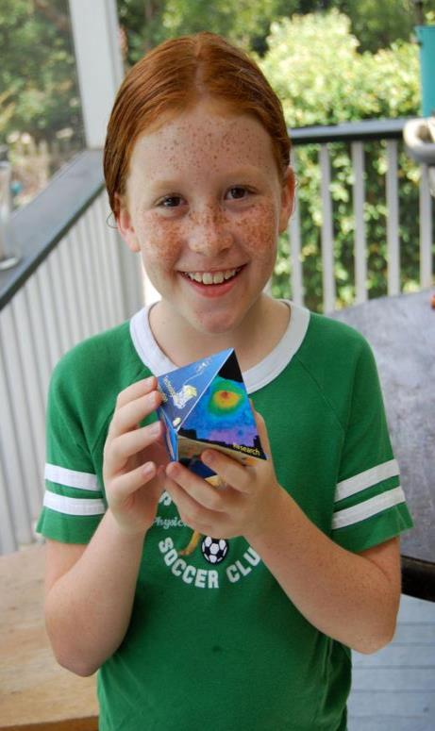
To Boldly Go…
Page 9
Learning Shapes

Slide 18
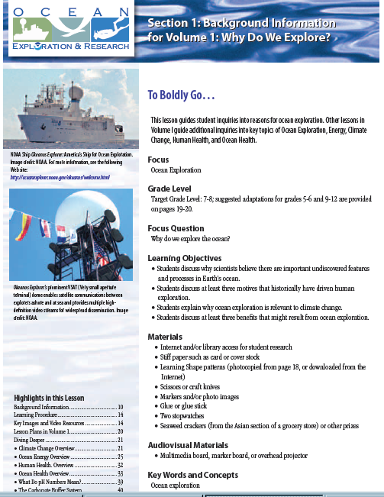
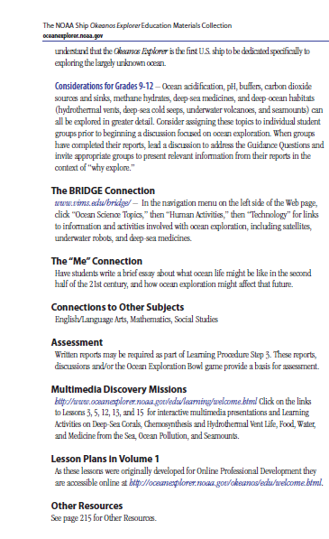
Why Do We Explore?
Book Overview

Slide 19
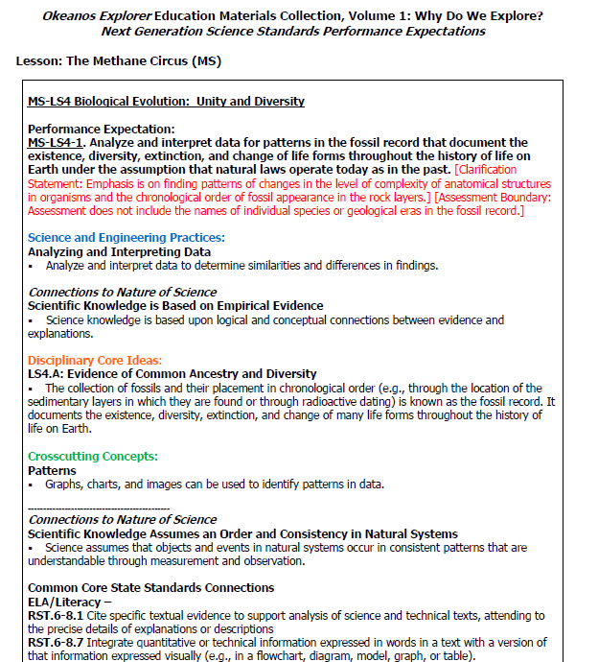
Standards

Slide 20
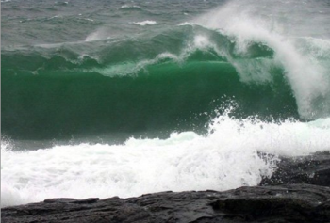
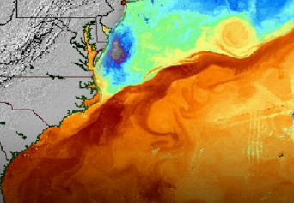
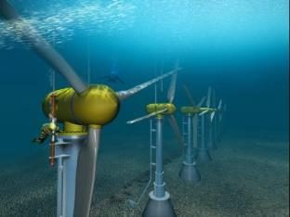
Ocean Energy
Waves: Highest energy density of any renewable resource
Tides (dams): 16-24 foot tidal range needed to be economical
Currents: 1% of Gulf Stream energy could power the state of Florida!
OTEC (thermal): Solar radiation absorbed by the ocean converted into electric
power (Ocean Thermal Energy Conversion)
Wind: Turbines; offshore winds stronger than on land
See Diving Deeper, pgs. 26-32 for detailed discussion

Slide 21
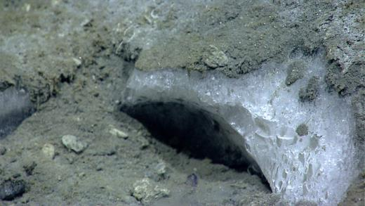
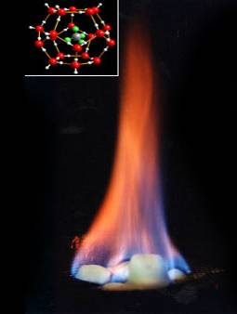
Methane Hydrates
Frozen water molecules which enclose methane molecules; no bonds between them = clathrate
Formed at low temperature, high pressure
May contain twice the carbon in all the coal, oil, and natural gas combined!
Burns when lit!
Notes:
Image: Methane Ice found during 2013 Northeast Canyons Expedition
Image: Methane hydrate will burn when lit. Top image shows structure of methane hydrate, the green and grey molecule in the center is methane and the red cage is the ice structure.

Slide 22
What’s the Big Deal?
Section 4, page 147 (9-12)
Student research of methane hydrates
Model building
Methane hydrate model

Slide 23
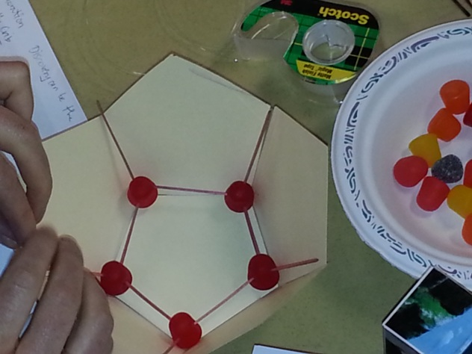
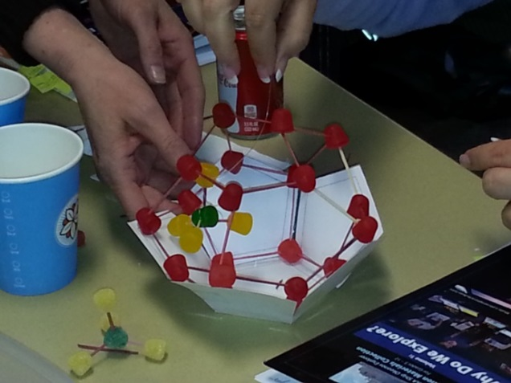
Build a Methane Hydrate Model
Follow directions on page 157, Steps 3-6.

Slide 24
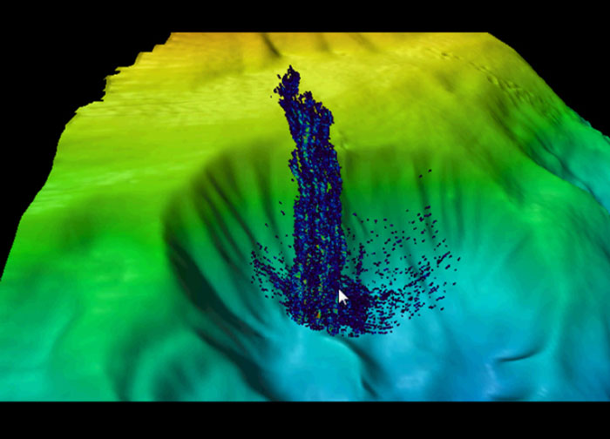

Slide 25
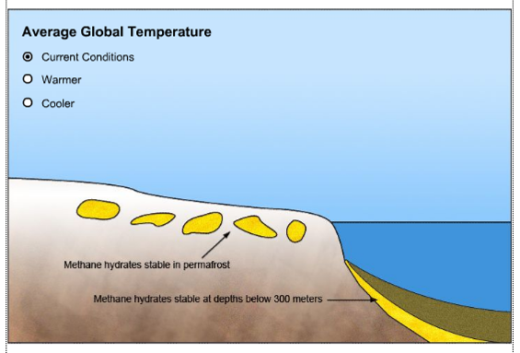
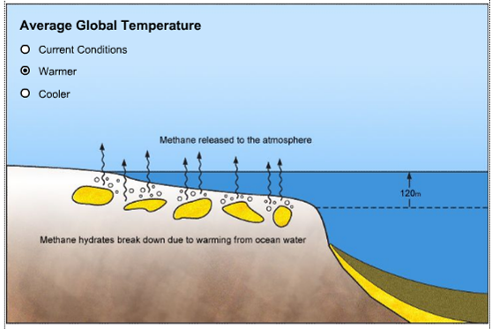
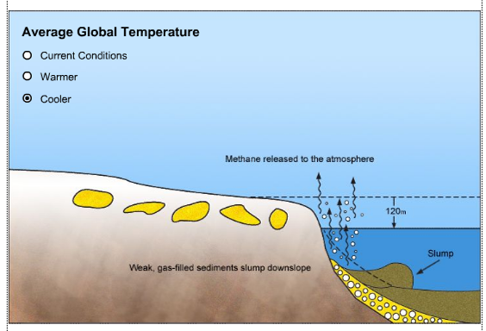

Slide 26
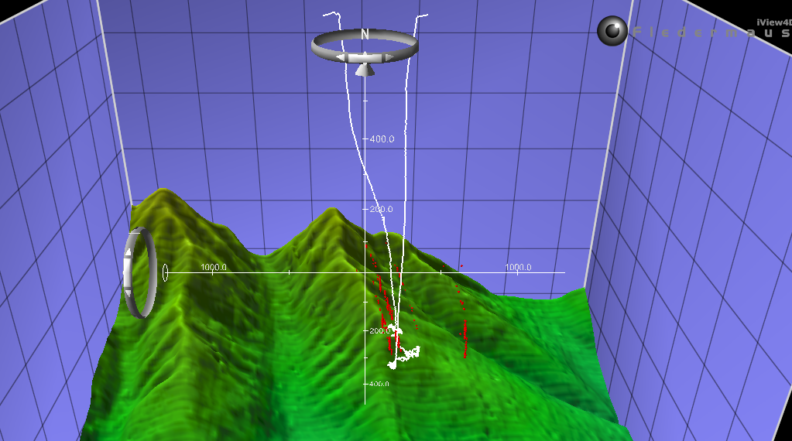

Cold Seep Discoveries

Slide 27

Ocean Health
Known, familiar threats to our ocean:
Over-exploitation of larger species; overfishing
Destruction of benthic habitats
Invasive species
Pollution (toxins, nutrients, marine debris…)
See Diving Deeper, pgs. 33-41 for detailed discussion

Slide 28

Ocean Health
Increased attention toward:
Increased temperature
Sea level rise
Ocean acidification
CO₂ increase in the atmosphere =
↑ in dissolved CO₂ in the ocean = ↓ pH
↓ carbonate ions essential for shells/skeletal structures

Slide 29
Ocean Health
Diving Deeper, page 40-41
The Carbonate Buffer System
CO₂ + H₂O < > H₂CO₃ < > H⁺ + HCO₃⁻ < > 2H⁺ + CO₃²⁻
Bicarbonate forms more
easily and quickly
Grabs carbonate out of
the system
carbon dioxide
water
carbonic acid
hydrogen ion
bicarbonate ion
hydrogen ion
carbonate ion
Wait! I need carbonate ions for my shell!

Slide 30

Ocean Literacy Essential Principles
Curriculum Standards Reflections

Slide 31


Exploration Strategy:
Sticks and Boxes
How do we decide where to explore?

Slide 32



Exploration Strategy
Reconnaissance:
Mapping ocean floor and exploring water column in transit
Multibeam sonar
Water Column Exploration:
Taking measurements top to bottom throughout water column when stopped
Conductivity, Temperature & Depth Profiler (CTD)
Site Characterization:
Collect more details including still images and video
ROV

Slide 33
How Do We Explore?
Overview

Slide 34

Standards

Slide 35


Exploration Tools and Technologies
Multibeam Sonar
CTD (Conductivity, Temperature, Depth)
ROV (Remotely Operated Vehicle)
Telepresence

Slide 36



Multibeam Sonar
Look how far we’ve come…

Slide 37




Wet Maps (5-6)
Pg. 51

Slide 38

Wet Maps (5-6)
Pg. 51

Slide 39



Wet Maps (5-6)
Pg. 51

Slide 40


Watching in 3D (9-12)
Pg. 77

Slide 41
Ocean Literacy Essential Principles
Curriculum Standards Reflections

Slide 42
Exploration Tools and Technologies
Multibeam Sonar
CTD (Conductivity, Temperature, Depth)
ROV (Remotely Operated Vehicle)
Telepresence

Slide 43


Conductivity, Temperature, and Depth Meter (CTD)

Slide 44

What’s a CTD (5-6)
Pg. 91
Searching for anomalies:
What type of CTD data could reveal the presence of hydrothermal vents or volcanoes?

Slide 45

The Oceanographic Yo-Yo (7-8)
Pg. 101

Slide 46


Slide 47



Slide 48
Ocean Literacy Essential Principles
Curriculum Standards Reflections

Slide 49

Ocean Explorer Website
Education Resources:
Professional Development
Webinars
Lesson Plans
Expedition Education Modules

Slide 50

Digital Atlas

Slide 51
Exploration Tools and Technologies
Multibeam Sonar
CTD (Conductivity, Temperature, Depth)
ROV (Remotely Operated Vehicle)
Telepresence

Slide 52



Little Hercules, Seirios, and Deep Discoverer
Little Hercules, 4000 m
2010 – 2013
High Definition Cameras
Sensors
Seirios
Camera & lighting sled
Deep Discoverer, 6000 m
Spring 2013
High Definition Cameras
Manipulator arms for deploying sensors

Slide 53









Notes:
All images from 2013 NE US Canyons expedition- Deep Discoverer ROV
Row 1:
Deep sea crab
Cephalopod (Bobtail squid)
Deep sea crab
Row 2:
A view of the escape swimmer Benthothuria, flexing so strongly that the mouth has been brought into view.
Two squids attempt to mate in the Gulf of Mexico.
Octopus.
Row 3:
Glass Sponge on canyon wall
An aggregation of methane ice worms inhabiting a white methane hydrate. Studies suggest that these worms eat chemoautotrophic bacteria that are living off of chemicals in the hydrate.
A 'pregnant' coral. This is an octocoral, as evidenced by the eight tentacles you can see on its polyps. The white dots you see in its almost translucent body may be developing embryos – baby corals!

Slide 54


Little Hercules

Slide 55

Deep Discoverer

Slide 56

Engineering Design
Define problem
Gather relevant information
Brainstorm possible solutions
Analyze possible solutions/select most promising
Test the solution

Slide 57


Invent a Robot (5-6)
Pg. 125
Task: Build a model that demonstrates how hydraulic actuators could be used for a robotic arm able to pick up objects about the size of a soda can from the ocean floor.

Slide 58
Attach the two pieces with screw, washers and nut as shown on pg. 131. (An extra nut between the two pieces of cardboard = ease of motion.)
Take 6” of duct tape, tear it lengthwise. Tear one of the pieces lengthwise again.
Tear one narrow piece of duct tape in half and wrap it around the plunger of one syringe.
Take ~ 3 in. of tape and tape the plunger to the smaller of the two pieces of cardboard (the part of the arm that will move).
Tape body of syringe onto the larger piece of cardboard as shown on page 132.
Firmly press one end of plastic tubing onto the end of the OTHER syringe.
Place the other end of the tubing into a small container of water. Pull the plunger back and forth until it and the tubing are both full with no air pockets. (Hold the water vessel higher than the syringe to do this.)
Plug the tube with your finger and, holding the open end higher than the syringe, attach the end to the syringe on your “arm”.
Slowly press the plunger on the unattached syringe - what happens?!

Slide 59

Syntactic Foam
Glass microspheres within a matrix of epoxy resin
Used in parts of airplanes, boat hulls, ROVs, AUVs, soccer balls

Slide 60

http://www.immersionlearning.org/index.php?option=com_wrapper&Itemid=216

Slide 61
Ocean Literacy Essential Principles
Curriculum Standards Reflections

Slide 62

Group Planning

Slide 63
Exploration Tools and Technologies
Multibeam Sonar
CTD (Conductivity, Temperature, Depth)
ROV (Remotely Operated Vehicle)
Telepresence

Slide 64




Telepresence

Slide 65


What Little Herc Saw (7-8)
Pg. 137
Demonstrate a process for analyzing video data from the Okeanos Explorer’s underwater robot.

Slide 66


Notes:
Top image, Indonesia near a seamount – area of high diversity.
Bottom image, Gulf of Mexico. Area of low diversity - underwater rivers and ponds of liquid brine. Anemones and some coral observed.

Slide 67


Event Log

Slide 68

Notes:
http://oceanexplorer.noaa.gov/okeanos/edu/ resources/media/movies/0711_site_k_transit_video.html

Slide 69

How do we use imagery in ocean exploration?
What are some of the challenges with using image data?

Slide 70
Ocean Literacy Essential Principles
Curriculum Standards Reflections

Slide 71


Slide 72


Notes:
http://www.youtube.com/watch?v=HDjqBNMWniY&feature=BFa&list=SP05ED679DD1E1DB17
From the Gulf of Mexico 2012 expedition.

Slide 73

Final Reflections
Notes:
Image: Bobtail squid in Atlantis Canyon off the east coast of the US.

Slide 74
Contact Information
Today’s Facilitator
___________, _________________
NOAA OER Education Specialist
Debi Blaney, debi.blaney@noaa,.gov
NOAA OER Education Program Manager
Susan Haynes, susan.haynes@noaa.gov
NOAA OER Education Director
Paula Keener, paula.keener@noaa.gov
This program has been made possible with support of the
National Marine Sanctuary Foundation.

